Slide 1
A Chronological Review of Deep Learning Models for Epidemic Forecasting
Ph.D. Qualifier Examination
Akash Choudhuri
Department of Computer Science
University of Iowa
22nd September 2022

Slide 2
Contents
Introduction
Problem Setting
Models
Paper 1: EpiDeep
Paper 2: Cali-Net
Paper 3: EpiFNP
Discussion

Slide 3
Epidemics and Pandemics
Introduction
An Epidemic is defined as “a widespread occurrence of an infectious disease in a community at a particular time”
A Pandemic is defined as “an outbreak of a disease that occurs over a wide geographic area (such as multiple countries or continents) and typically affects a significant proportion of the population”

Slide 4
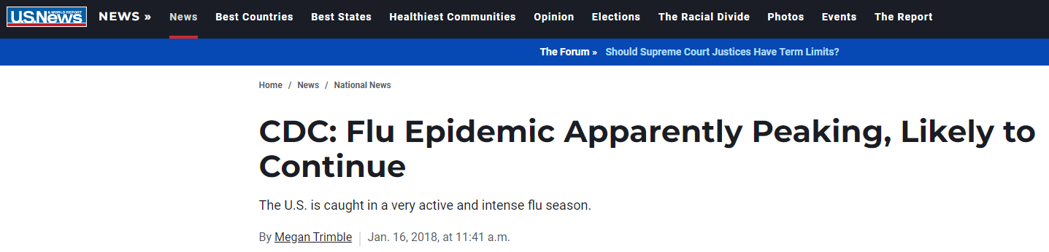
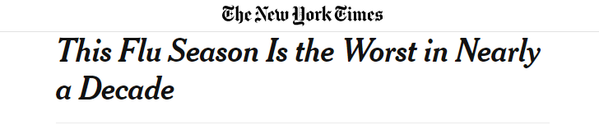

Epidemics and Costs
Introduction
Costs of the Influenza Epidemic in USA (October, 2021 – June, 2022):
Estimated Deaths: 5000 to 14000.
Estimated Hospitalizations: 82,000 – 170,000.

Slide 5
How to Tackle the Problem
Introduction
Build better policies to combat the disease
Build accurate and generalizable forecasting models which will predict the future given the current data
How does that help?
Informs policy makers enough to efficiently allocate funds/ resources
Influences control measures (lockdowns, temporary medical centers)
Prepares the general public for the future

Slide 6
Papers
Introduction
[Paper 1] Bijaya Adhikari, Xinfeng Xu, Naren Ramakrishnan, B. Aditya Prakash, “EpiDeep: Exploiting Embeddings for Epidemic Forecasting”, KDD ’19
[Paper 2] Alexander Rodríguez, Nikhil Muralidhar, Bijaya Adhikari, Anika Tabassum, Naren Ramakrishnan, B. Aditya Prakash, “Steering a historical disease forecasting model under a pandemic: Case of flu and COVID-19”, AAAI ‘21
[Paper 3] Harshavardhan Kamarthi, Lingkai Kong, Alexander Rodríguez, Chao Zhang, B. Aditya Prakash, “When in doubt: Neural non-parametric uncertainty quantification for epidemic forecasting”, NeurIPS ‘21

Slide 7
Contents
Introduction
Problem Setting
Models
EpiDeep
Cali-Net
EpiFNP
Discussion

Slide 8
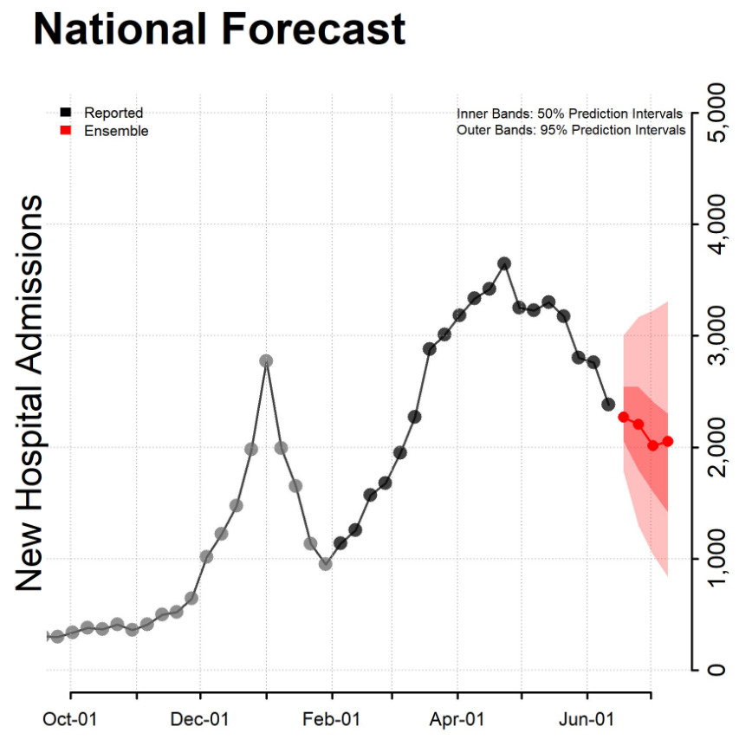
FluSight
Problem Setting
CDC organizes annual Influenza Forecasting Challenge:
Output: Signals that include forecasts about:
Future Incidence
Seasonal Peak Intensity
Seasonal Peak Week
Onset Week
Notes:
Effective February 2, 2022, hospitals are required to report laboratory-confirmed influenza hospitalizations to HHS Protect daily. Prior to this update, reporting influenza hospitalizations was optional (noted as grey in the above figure)
Inspired

Slide 9
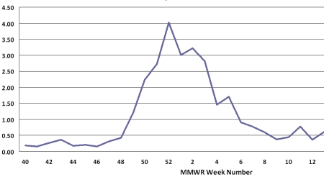
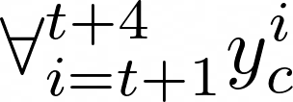
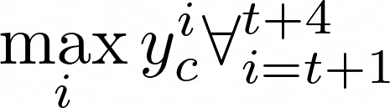
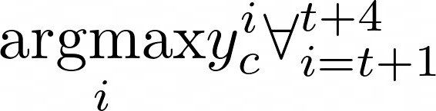
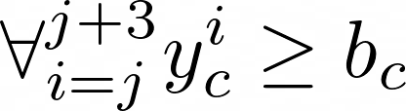
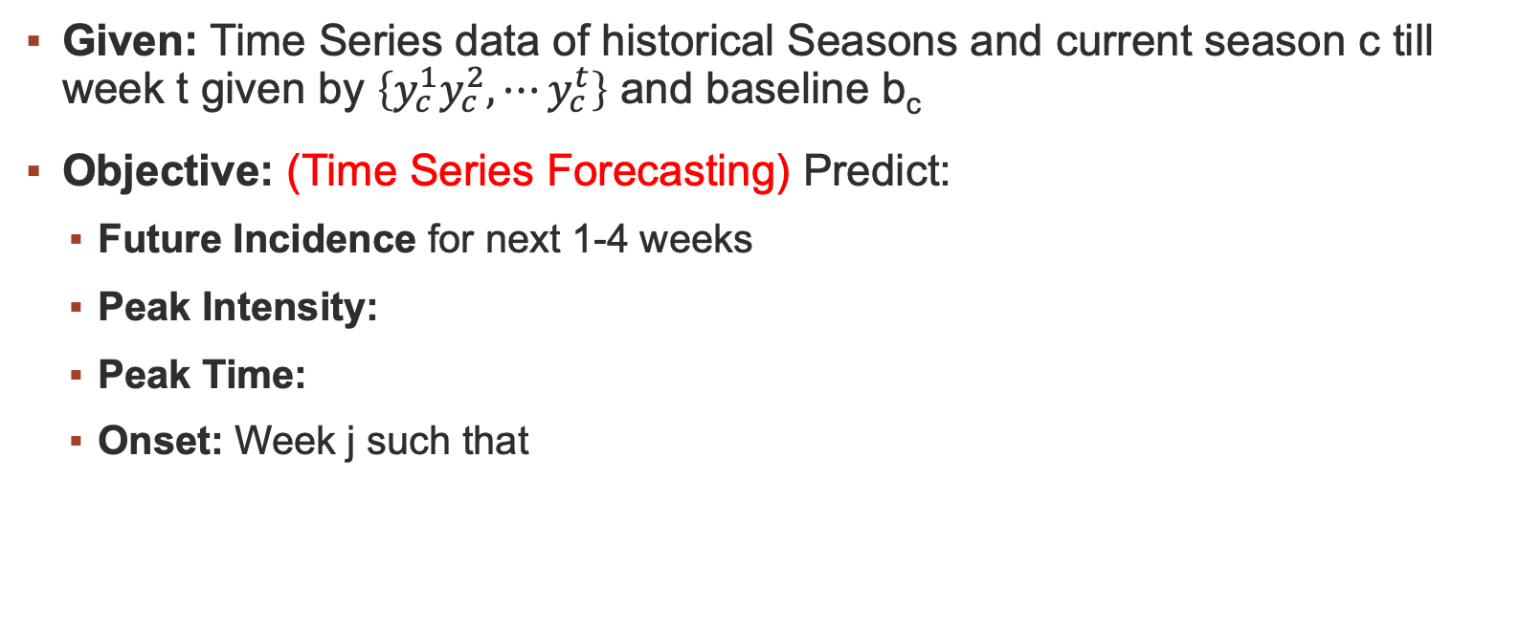
Main Objectives
Problem Setting
Given: Time Series data of historical Seasons and current season c till week t given by $\left\{y_{c}^{1}y_{c}^{2},⋯y_{c}^{t}\right\}$ and baseline b_{c}
Objective: (Time Series Forecasting) Predict:
Future Incidence for next 1-4 weeks
Peak Intensity:
Peak Time:
Onset: Week j such that
Notes:
The V means for all

Slide 10
Challenges
Problem Setting
Backfill: Data is constantly revised over time
Sparsity: Only a single number is given for every week starting from 1997
Contamination: In the recent times, diseases with similar symptoms (eg, COVID-19) contaminate the raw ILI numbers

Slide 11
Contents
Introduction
Problem Setting
Models
Paper 1: EpiDeep
Paper 2: Cali-Net
Paper 3: EpiFNP
Discussion

Slide 12
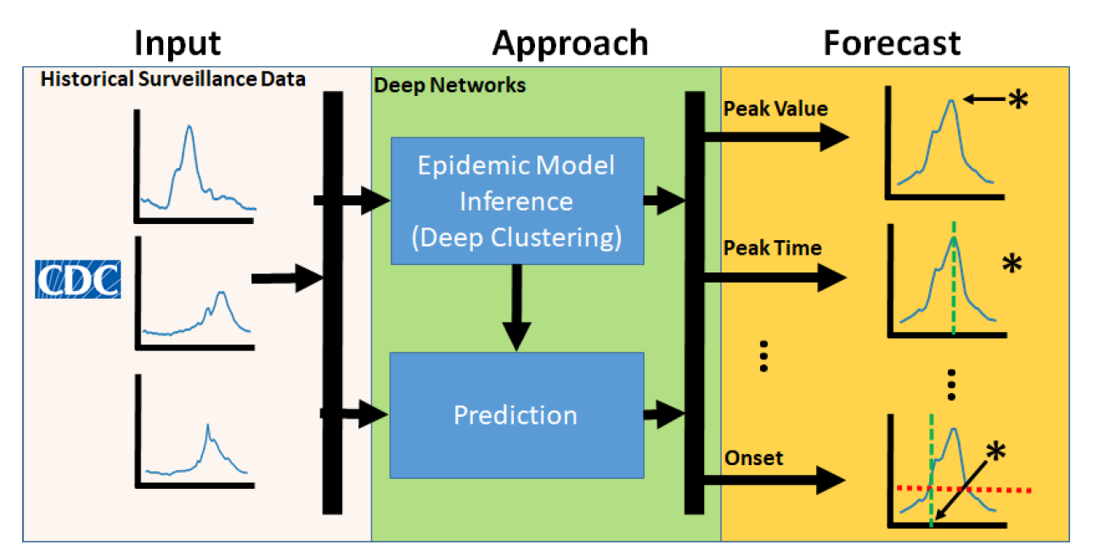
Overview
Epideep
Feed Historical Data into model (training set)
Model learns to embed seasons in a latent space and cluster closely related seasons. Each season begins at week 20 of the calendar year
Model tries to see which previous season was closer to current season and predicts accordingly.

Slide 13
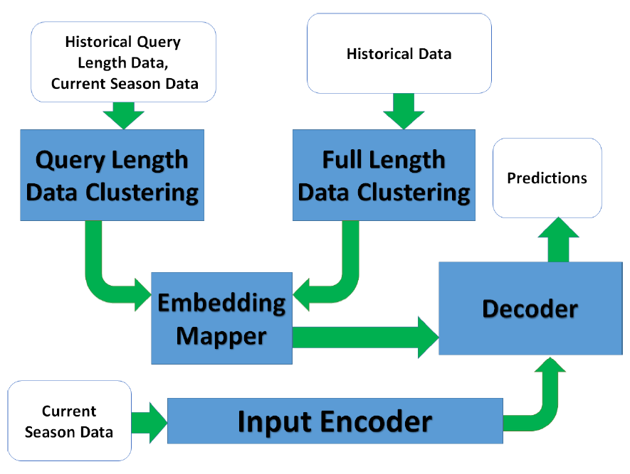
Model Architecture
Epideep

Slide 14
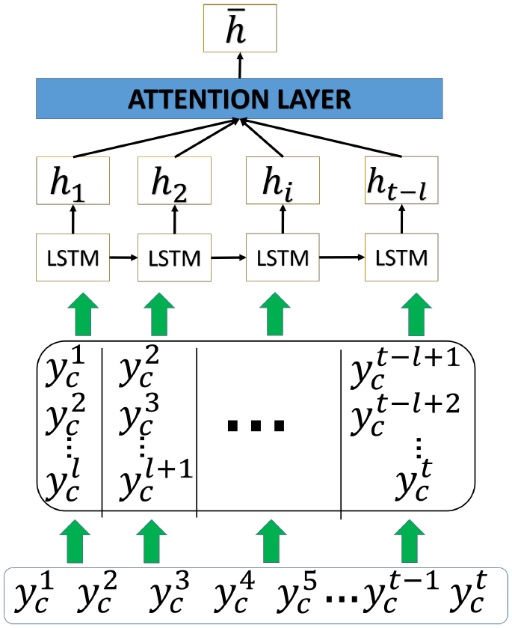
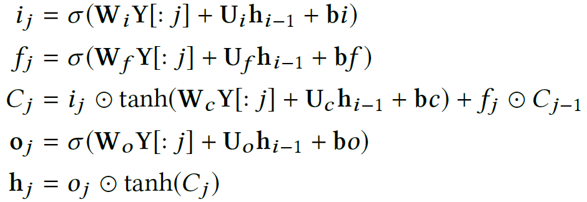
Input Encoder
Epideep
The matrix generated from input sequence is fed into a LSTM column wise as shown below:
The LSTM equations are:
Notes:
First gate is input gate
Second gate is forget gate
Third is internal state update
Fourth is output gate

Slide 15
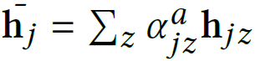
Input Encoder
Epideep
ILI surveillance data is often delayed and takes multiple timestamps to stabilize (data revision). So, the most recent timestamp will change over time
In traditional LSTM design, the final sequence is the most important
So, over reliance on the last timestamp could harm the predictive power of the model
So, attention mechanism is used on the output of the LSTM as a weighted sum of all previous hidden states
This output is fed to the decoder
context vector for j^{th} input
weight associated with the prior hidden state
Notes:
Text generation in sentences in NLP

Slide 16
Historical Data Clustering
Epideep
We could simply feed the output of the attention model to the decoder and make predictions. (Model may not generalize well)
But Data is sparse
So, there is a need to capture similarities between seasons to provide more information
This is done by learning embeddings of the partially observed current season in the latent space to minimize the distance between this embeddings and those of the historical seasons
This is done by:
Query Length Data Clustering
Full Length Data Clustering

Slide 17
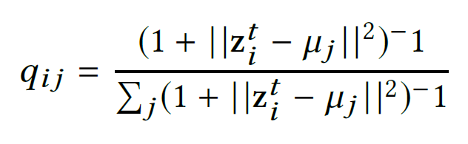
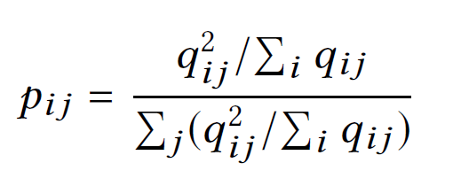
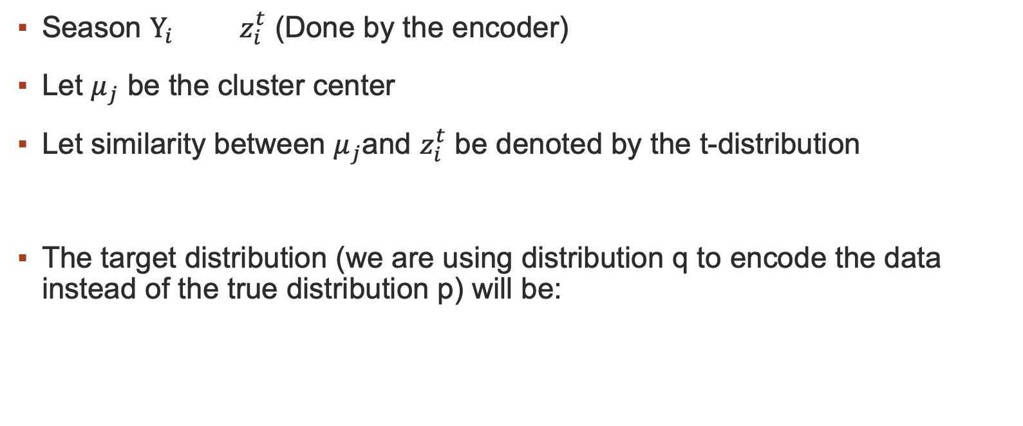
Query Length Data Clustering
Epideep
Season $Y_{i} { z}_{i}^{t}$ (Done by the encoder)
Let $μ_{j}$ be the cluster center
Let similarity between $μ_{j}$and $z_{i}^{t}$ be denoted by the t-distribution
The target distribution (we are using distribution q to encode the data instead of the true distribution p) will be:

Slide 18
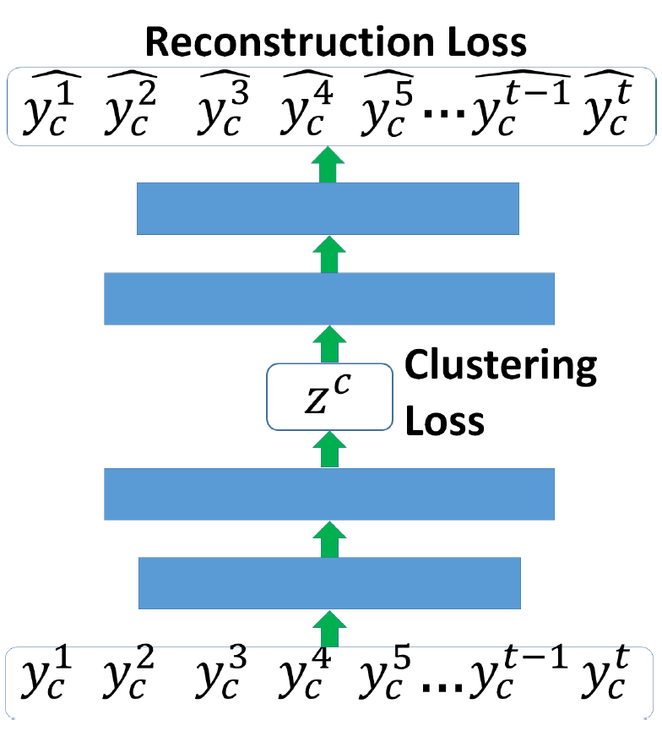
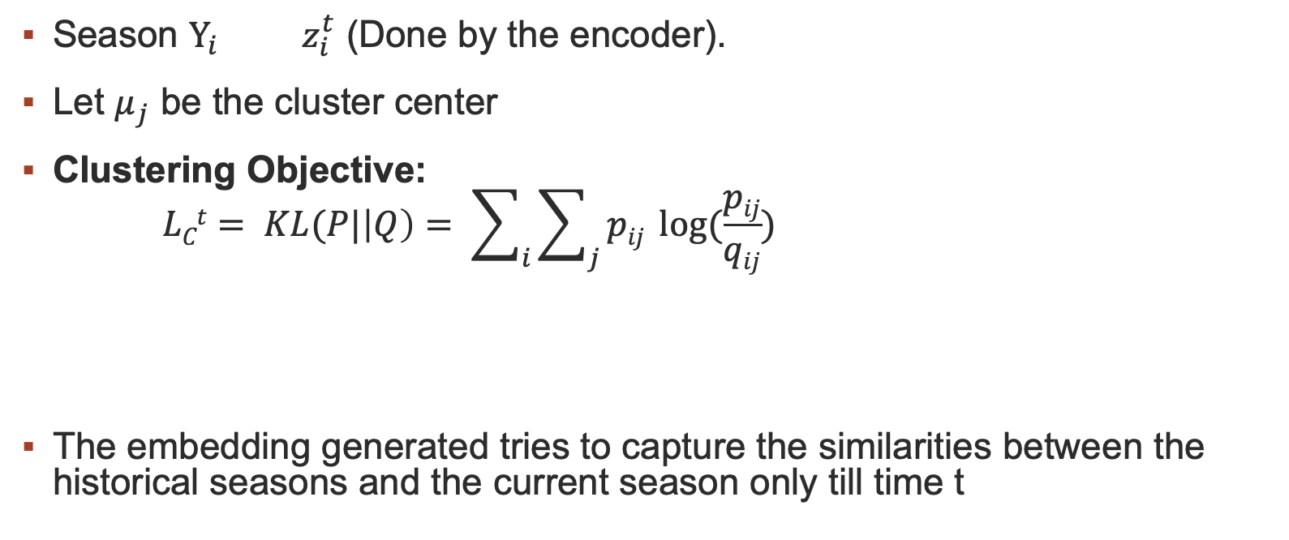
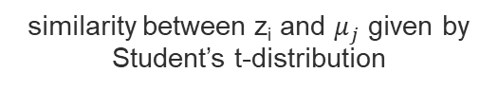
Query Length Data Clustering
Epideep
Season $Y_{i} { z}_{i}^{t}$ (Done by the encoder).
Let $μ_{j}$ be the cluster center
Clustering Objective:
$$LCt= KL(P|\left|Q\right)= \sum_{i}{\sum_{j}{pij \log{(\frac{pij}{qij})}}}$$
The embedding generated tries to capture the similarities between the historical seasons and the current season only till time t
target distribution
clustering loss
similarity between z_{i} and $μ_{j}$ given by Student’s t-distribution

Slide 19
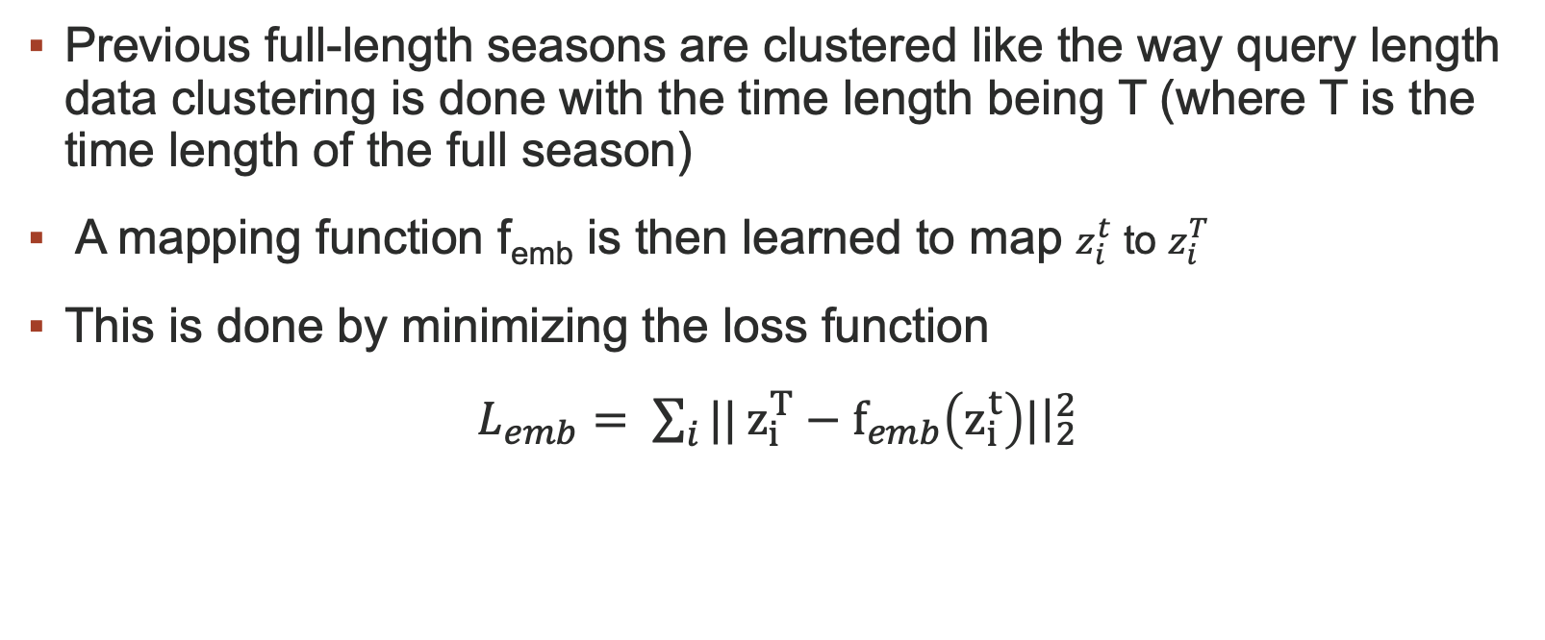
Full Length Data Clustering and Mapping
Epideep
Previous full-length seasons are clustered like the way query length data clustering is done with the time length being T (where T is the time length of the full season)
A mapping function f_{emb} is then learned to map $z_{i}^{t}$ to $z_{i}^{T}$
This is done by minimizing the loss function
$L_{emb}= \sum_{i}{||}z_{i}^{T}−f_{emb}\left(z_{i}^{t}\right)|{\left.​\right|}_{2}^{2}$

Slide 20
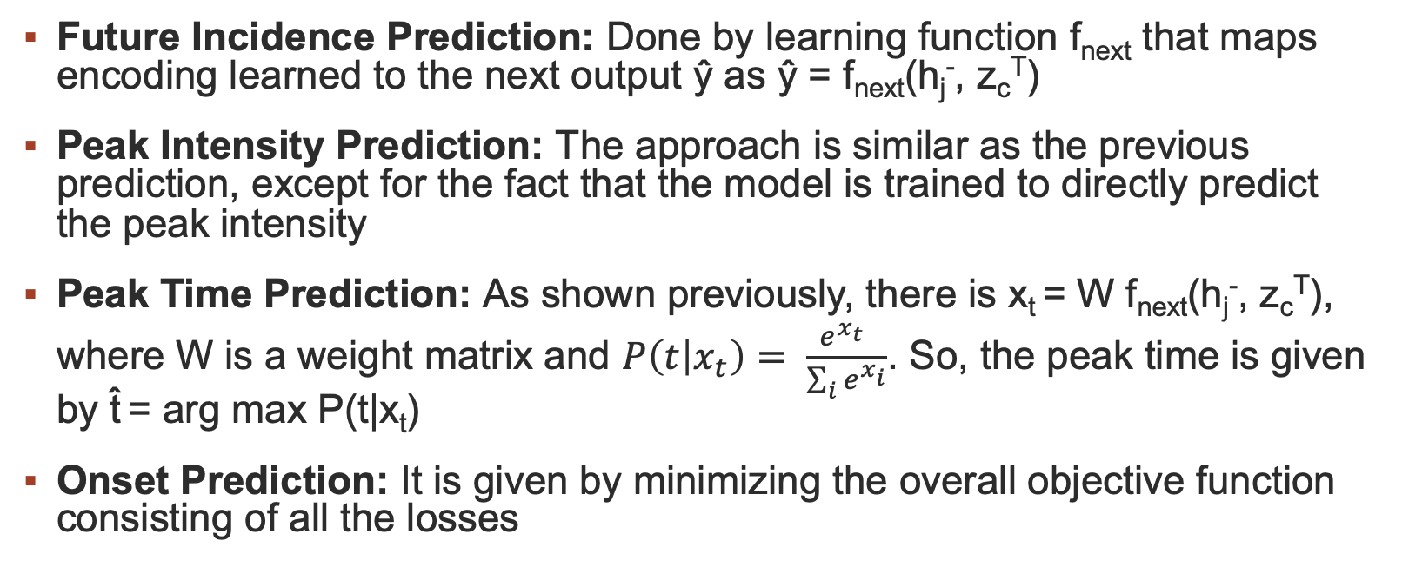
Optimization and Prediction
Epideep
Future Incidence Prediction: Done by learning function f_{next} that maps encoding learned to the next output ŷ as ŷ = f_{next}(h_{j}⁻, z_{c}^{T})
Peak Intensity Prediction: The approach is similar as the previous prediction, except for the fact that the model is trained to directly predict the peak intensity
Peak Time Prediction: As shown previously, there is x_{t} = W f_{next}(h_{j}⁻, z_{c}^{T}), where W is a weight matrix and $P\left(t | x_{t}\right)= \frac{e^{x_{t}^{}}}{\sum_{i}{e^{x_{i}}}}$. So, the peak time is given by t̂ = arg max P(t|x_{t})
Onset Prediction: It is given by minimizing the overall objective function consisting of all the losses

Slide 21
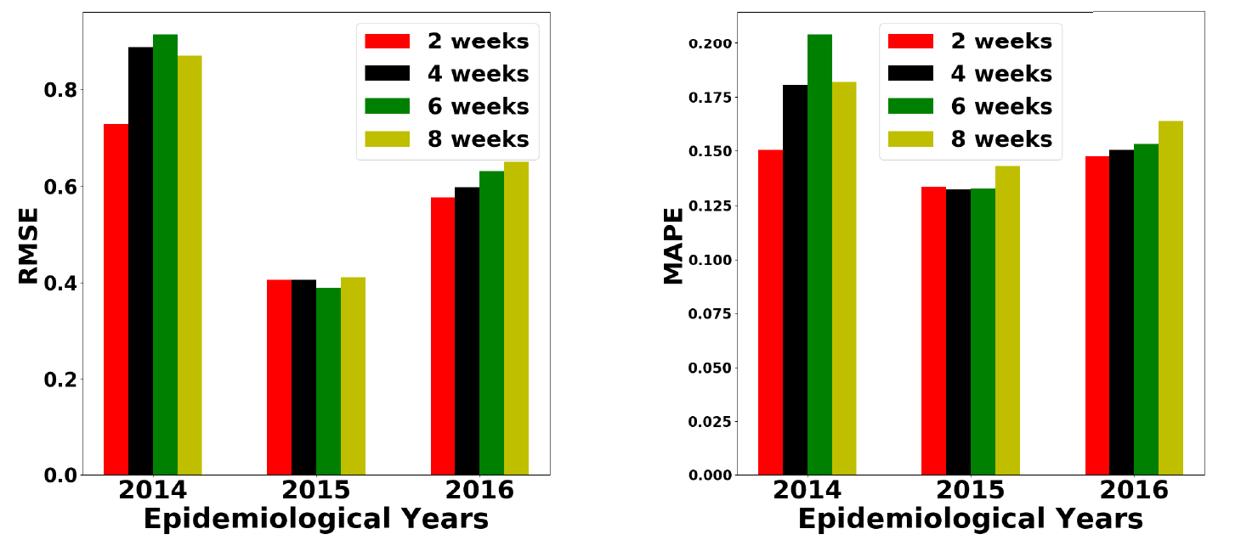
Results- EpiDeep
EpiDeep
Delayed Data Arrival

Slide 22
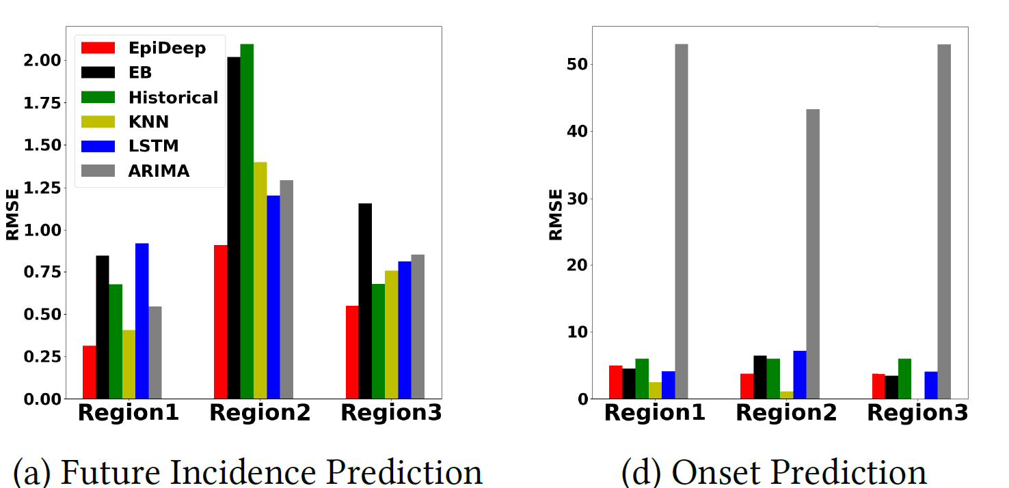
Results- EpiDeep
EpiDeep
Regional Forecasting

Slide 23
Contents
Introduction
Problem Setting
Models
Paper 1: EpiDeep
Paper 2: Cali-Net
Paper 3: EpiFNP
Discussion

Slide 24
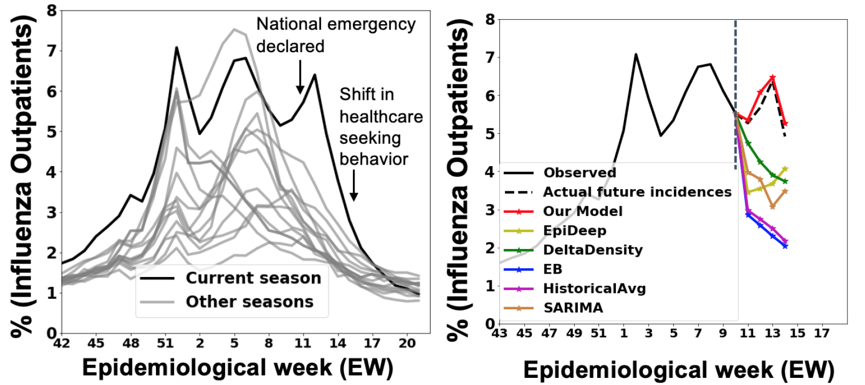
Context
Cali-NET
During the early stages of COVID-19, wILI counts were getting contaminated by COVID-19 case numbers
This was due to symptomatic similarities of COVID and influenza, which called for a framework which can disambiguate trends between historical strains and new emerging strains during the flu season

Slide 25
How to Incorporate COVID-19?
Cali-NET
Leverage external COVID-19 related signals: (Very Less Data Exists)
Confirmed Cases
Hospitalizations
Emergency Room Visits
Utilization of Transfer Learning and Knowledge Distillation Techniques to ensure effective transfer of COVID-19 knowledge to the historical wILI trends
To alleviate data paucity, a single global architecture with explicit spatial constraints is trained to model COVID-ILI trends of all regions

Slide 26
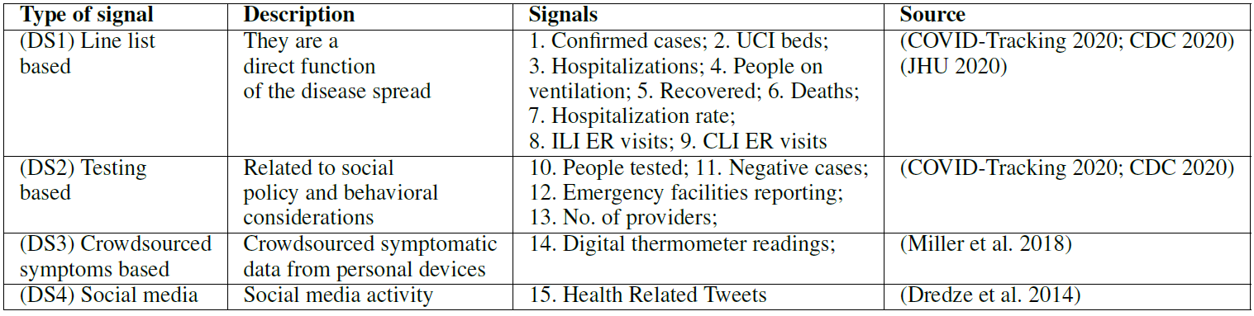
Exogenous COVID-19 Signals
Cali-NET
Notes:
Emergency Roons
COVID like illness

Slide 27
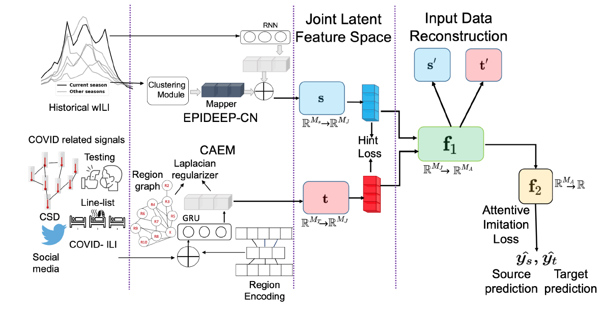
Model Architecture
Cali-NET

Slide 28
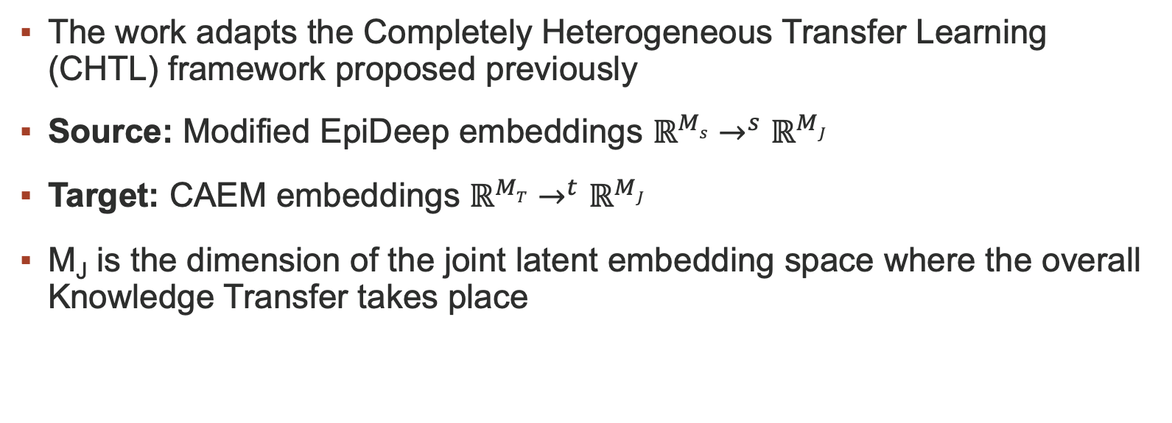
Learning Representations from Historical ILI Data and Heterogenous Transfer Learning
Cali-NET
The work adapts the Completely Heterogeneous Transfer Learning (CHTL) framework proposed previously
Source: Modified EpiDeep embeddings $ℝ^{Ms}$ $→^{s}$ $ℝ^{MJ}$
Target: CAEM embeddings $ℝ^{MT}$ $→^{t}$ $ℝ^{MJ}$
M_{J} is the dimension of the joint latent embedding space where the overall Knowledge Transfer takes place

Slide 29
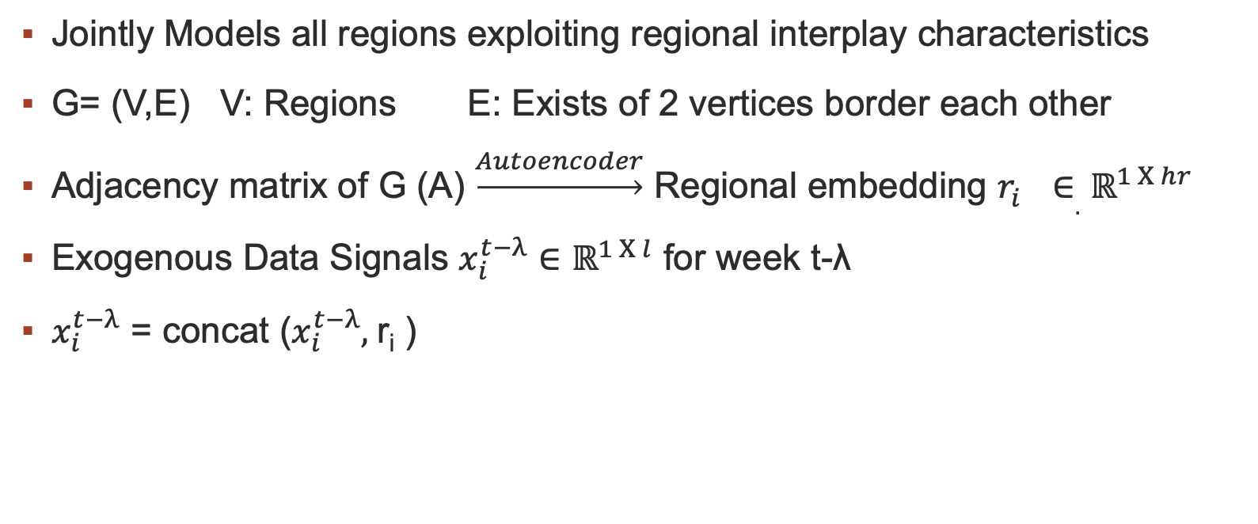
COVID-Augmented Exogenous Model (CAEM)
Cali-NET
Jointly Models all regions exploiting regional interplay characteristics
G= (V,E) V: Regions E: Exists of 2 vertices border each other
Adjacency matrix of G (A) $\underset{→}{Autoencoder}$ Regional embedding $r_{i}^{}∈.$ $ℝ^{1 Χ hr}$
Exogenous Data Signals $x_{i}^{t−λ}∈$ $ℝ^{1 Χ l}$ for week t-λ
$x_{i}^{t−λ}$ = concat ($x_{i}^{t−λ},$r_{i} )

Slide 30
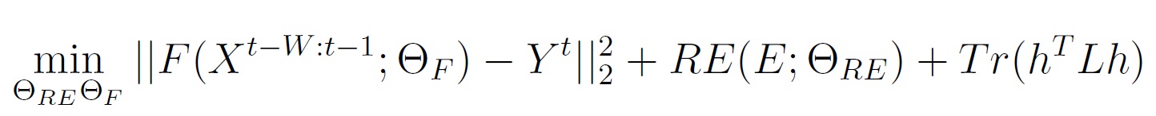
CAEM Continued
Cali-NET
The previously shown concatenated vector is passed through a GRU
GRU encodes temporal dependencies using data from week t-W to t-1 to predict values up to week t+k
The overall optimization objective for CAEM is:
L is the Normalized Laplacian Matrix
F is the Recurrent Forecasting Function
h is the hidden representation of the input sequence generated by F at the end of recurrence
Tr refers to trace
Notes:
F is the recurrent forecasting function accepts COVID related exogenous data for all regions for past few weeks. Output is forecast for all 11 regions
RE is region embedding (autoencoder) that accepts One Hot Encoding (E) of all regions.
h is hidden representation of F at the end of recurrence to enforce regional similarity governed by Laplacian L.

Slide 31
EpiDeep-CN (Modification of base EpiDeep Model)
Cali-NET
In This variant of EpiDeep, re-training of the same model is done incrementally for each week in the season
This allows for the Knowledge Distillation losses to be applied to the same set of EpiDeep parameters
Training Datasets of EpiDeep-CN and CAEM are not the same but share an overlapping subset from January 2020
Thus, Knowledge Distillation (KD) loss is only imposed for this subset of training data

Slide 32
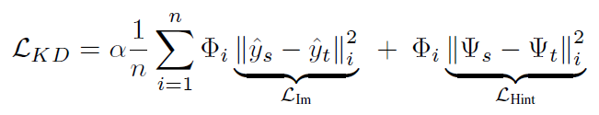
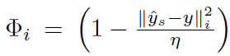
KD Loss
Cali-NET
The KD Loss is composed of 2 terms, namely imitation loss and hint loss. The overall loss equation can be expressed as:
Where,
n is the batch size
The goal of KD loss is to enforce unidirectional knowledge transfer from the source module (EpiDeep-CN) to the target module (CAEM)
So, KD losses do not affect the representations learned by the EpiDeep-CN module

Slide 33
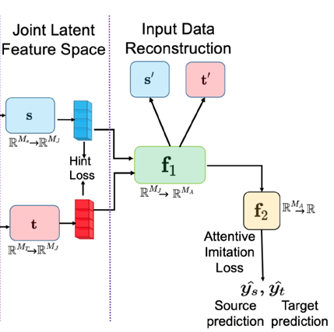
KD Loss
KD Loss:
Notes:
Now, if we define student loss and teacher loss as the error of student and teacher networks respectively w.r.t ground truth, we define Imitation Loss as error of student network w.r.t. teacher network. However, in our given case, Epideep-CN (teacher) model’s predictions are necessarily not reliable. In that case, we would want to model the uncertainty of the teacher model by not a parametric distribution but by using empirical error of the teacher model’s prediction w.r.t. ground truth. Then the objective function is modified as shown in Saputra et al.’s paper.
So, essentially, attentive imitation loss amalgamates loss of both student model with respect to ground truth and teacher model with respect to ground truth as well as loss of student model with respect to teacher model by also modeling the uncertainty of teacher model’s predictions.
In hint loss, as used in hint training where the intermediate representation of student model is trained so that it can mimic teacher model’s latent representation, Saputra et al. argues that teacher model is not a perfect estimator and may give wrong information to student model at times.
So, hint loss considers the output embeddings of student and teacher models, but attentive imitation loss considers the predictions of student and teacher models.

Slide 34
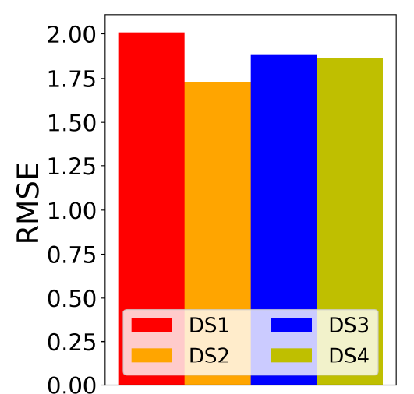
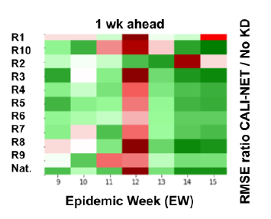
Ablation Study- Cali-NET
Cali-NET
How important is KD? each box is colored by the ratio of RMSE of CALI-NET and its variant (capped at -1 and 1 to help visualization). Green cells indicate that CALINET does better while red cells indicate that CALINET w/o KD losses does better.
How important are exogenous signals? Line List based data (DS1) is very helpful in COVID-ILI forecasting while the effectiveness of testing (DS2) and crowdsourced based (DS3) data is slightly more varied across regions

Slide 35
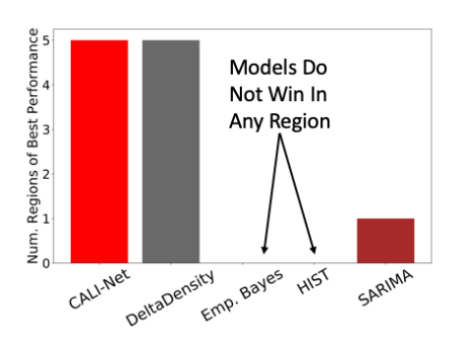
Results- Cali-NET
Cali-NET

Slide 36
Contents
Introduction
Problem Setting
Models
Paper 1: EpiDeep
Paper 2: Cali-Net
Paper 3: EpiFNP
Discussion

Slide 37
Problems of Prior Models
EpiFNP
Statistical Approaches for the forecasting problem are fairly new
Mechanistic models have been the popular choice over time. However, they cannot leverage data from multiple indicators or predict composite signals
Deep learning approaches have been promising but they need to handle uncertainty to give reliable forecasts
So-called ‘point’ forecasts are not helpful as they are often not accounting for the uncertainty

Slide 38
Components
EpiFNP
EPIFNP has 3 key components:
Probabilistic neural sequence encoding: Uses a DSM to encode the sequence into a variational latent embedding
Stochastic correlation graph construction: Captures correlations between reference and training data points in the latent embedding space
Final predictive distribution parameterization: 3 stochastic latent variables, namely global and local stochastic latent variables and the stochastic sequence embeddings are passed to a MLP to give the distribution
Notes:
Deep Sequential Model

Slide 39
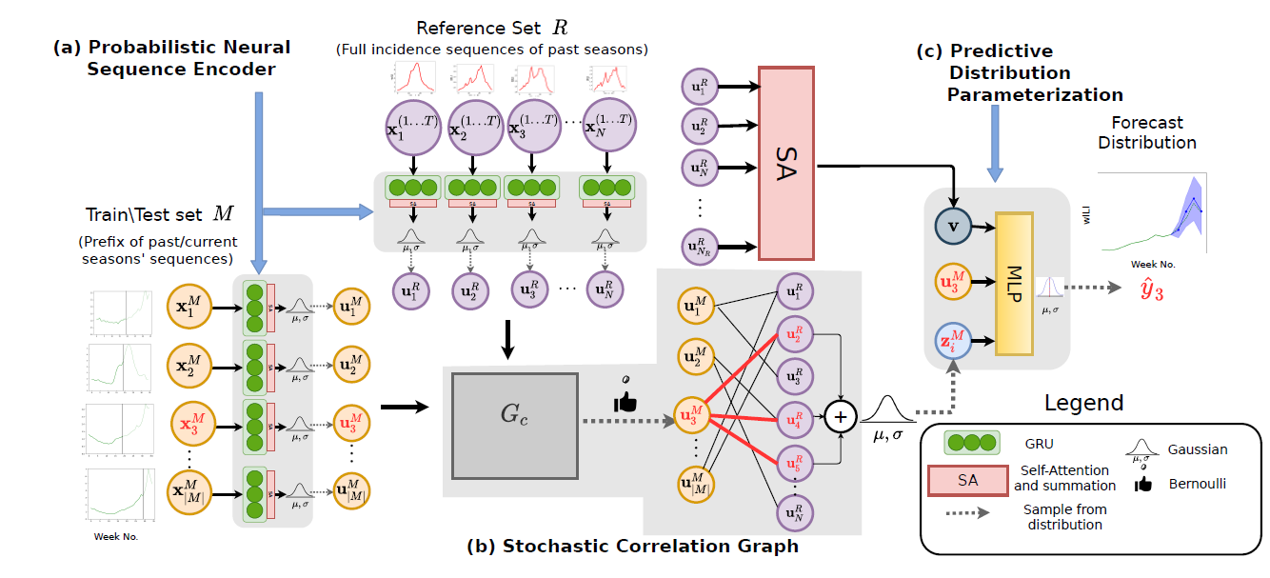
Model Architecture
EpiFNP

Slide 40
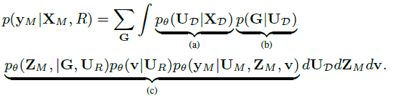
Optimization Function
EpiFNP
The Factorized Form of the predictive distribution of the training sequence is written as:

Slide 41
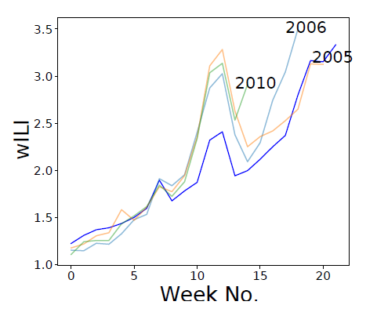
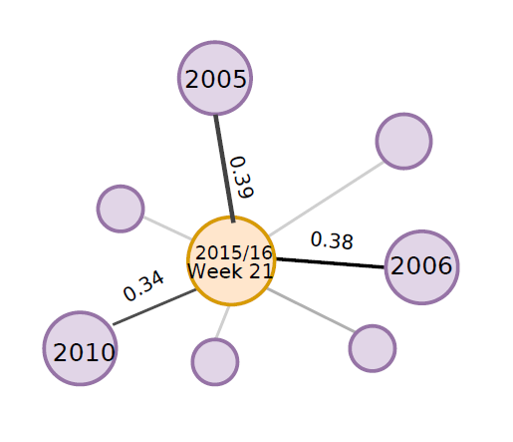
Results- EpiFNP
EpiFNP
EpiFNP automatically chooses most similar seasons for a given season.

Slide 42
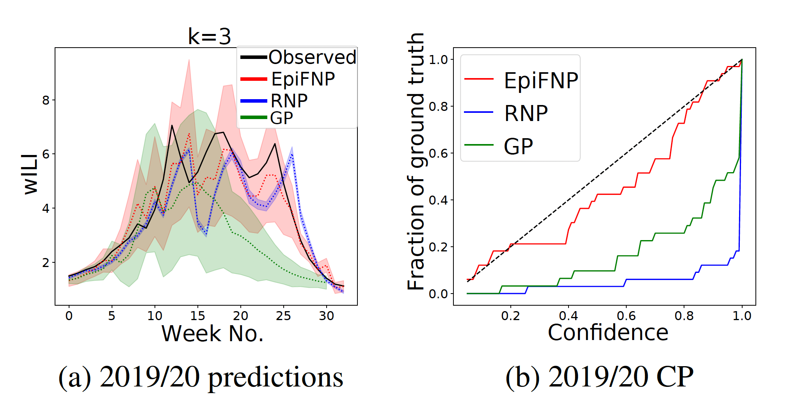
Results-EpiFNP
EpiFNP
EPIFNP outperforms top 2 baselines during abnormal COVID-19 season 2019/20

Slide 43
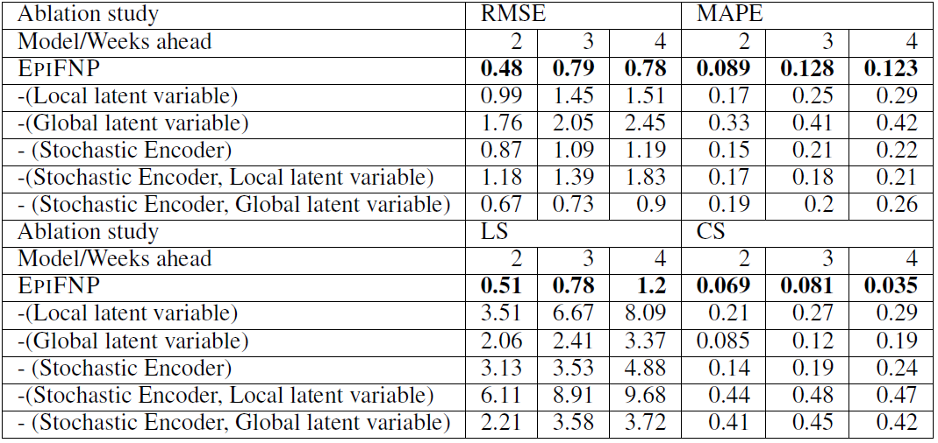
Ablation Study- EpiFNP
EpiFNP
Ablation study to measure the effects of different components of EpiFNP.

Slide 44
Contents
Introduction
Problem Setting
Models
Paper 1: EpiDeep
Paper 2: Cali-Net
Paper 3: EpiFNP
Discussion

Slide 45
Comparison of Methods
Discussion
Paper | COVID-19 | Prediction Type | Significance
Paper 1 | Absent | Point | First Deep Learning Framework Proposed for this task
Paper 2 | Present | Point | Effective Prediction in onset of similar diseases
Paper 3 | Present | Distribution with Uncertainty | Deep Learning Method Predicting with Uncertainty

Slide 46
Research Directions
Discussion
The above can be extended to handle other diseases and the core technique can be adapted for other general sequence modeling
Future variants of these models can also use heterogeneous data from multiple sources
Explore incorporating domain knowledge of prior dependencies between different sources/features
As data is sparse, works can be done to generate good quality synthetic data to improve performance of the models

Slide 47
Thank You
Questions? Comments?

Slide 48
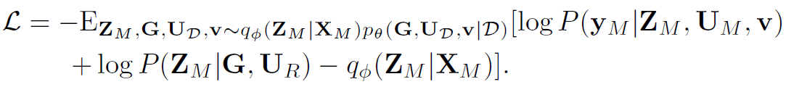
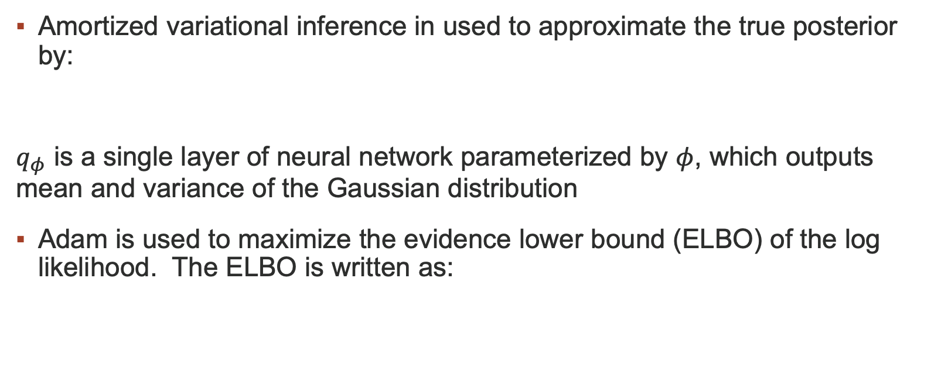
Learning the Distribution
EpiFNP
Amortized variational inference in used to approximate the true posterior by:
$q_{φ}$ is a single layer of neural network parameterized by $φ$, which outputs mean and variance of the Gaussian distribution
Adam is used to maximize the evidence lower bound (ELBO) of the log likelihood. The ELBO is written as:

Slide 49
Parameterizing Predictive Distribution
EpiFNP
Sequence embedding: A direct path from the latent embedding of the training sequence to the final prediction to enable the neural network to extrapolate beyond the distribution of the reference sequences. This is useful in novel/unprecedented patterns where the input sequence can not rely only on reference sequences from historical data for prediction
Concatenate the 3 variables into a single vector e_{i} and obtain the final predictive distribution where d₁ and d₂ are Multi-layer Perceptrons (MLPs):

Slide 50
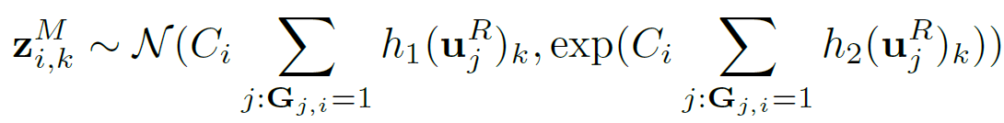
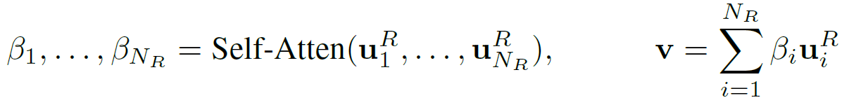
Parameterizing Predictive Distribution
EpiFNP
Functional uncertainty is captured from different perspectives:
Local latent variable: Summarizes the information of the correlated reference points for each training point and captures the uncertainty of data correlations. It is given by:
Global latent variable: Encodes the information in all the reference points.
Notes:
Local latent variable captures functional uncertainty at local level while global variable does it by summarizing the overall information of the underlying function

Slide 51
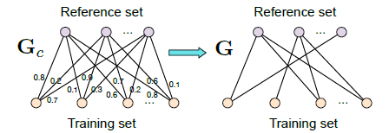
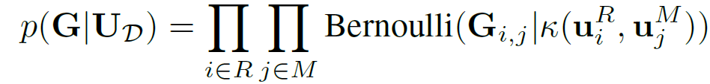
Stochastic Data Correlation Graph
EpiFNP
Bipartite graph from the reference set R to the training set M based on the similarity between their sequence embeddings
G (a stochastic binary bipartite Graph) encodes data correlations.
The Binary Adjacency Matrix is Parameterized by:

Slide 52
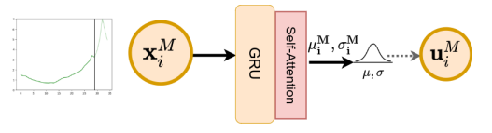
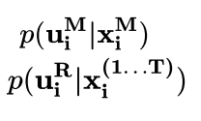
Probabilistic Neural Sequence Encoder
EpiFNP
Similar to input encoder of Epideep
U_{i} is then computed as a Gaussian having probability Distribution:
Where g₁ and g₂ are 2 MLPs and [.]_{k} is the k^{th} dimension of the variable

Slide 53

Learning the Distribution Continued
EpiFNP
After getting the optimal parameter, during testing, the predictive distribution of a new unseen partial sequence on the reference set is formulated by:

Slide 54






Setting
EpiFNP
During Training Phase, EPIFNP is trained to predict $x_{i}^{\left(t+k\right)}$ given $x_{i}^{\left(1,..,t\right)}$ as input for i$≤N$
Training Set (M): { , i$≤N$, t+k$≤T,$ } }
Reference Set (R):
Elements of M are, and elements of R are .
X_{D} is the union of the reference and training sequences

Slide 55


Objective
EpiFNP
Given a dataset of historical incidence sequences H and a snippet of current season N+1 till week t, estimate an accurate prediction of the next few future values (usually till 4 weeks in future)
Predict k week in future given H and $X_{N+1}^{\left(1…t\right)}$.

Slide 56
Stochastic Data Correlation Graph
EpiFNP
The Binary Adjacency Matrix is Parameterized by:

Slide 57



Notations
EpiFNP
$x_{i}^{\left(t\right)}$: Incidence for season i at week t
Current season= N+1 Current Week=t
The snippet of time series values up to week t is given by:
Data from past historical seasons 1 to N given by:
where T is the number of weeks per season.

Slide 58
Conclusions
EpiDeep
Strengths:
EpiDeep embeddings distinguish seasons with higher intensities from the ones with lower intensities
The learnt embeddings reveal temporal similarities between different seasons in the same region
Weaknesses:
EpiDeep cannot ingest data from multiple sources.

Slide 59



Data Collection
Problem Setting
Outpatient Influenza-like Illness Surveillance Network (ILINet):
ILINet providers tally and report each week the total number of patients seen at their practice for any reason
From this data, CDC gets % of people coming in with Influenza like Illness (ILI)
CDC releases the weighed Influenza like Illness data (wILI) counts every week
Historical ILI Data is also available
ILINet Surveilance Network

Slide 60
Challenge
Epideep
Current season is only observed till week t
But historical seasons are fully observed
Proposed Approach:
Model learns embeddings to capture similarities between current season and historical seasons (restricted at time t)
Model also learns embeddings of full length previous historical seasons without the current season
A mapping function is learnt to map these representations

Slide 61

Comparison of Methods: Cali-NET vs EpiDeep
Discussion
CALI-NET significantly outperforms EPIDEEP across all regions. The plot on the right shows that Cali-NET is effective at preventing negative transfer when wILI is no longer aligned with the exogenous COVID signals. The plot on the left shows that in general cases when both signals co-exist, Cali-NET also performs very well.

Slide 62
Query Length Data Clustering
Epideep
Deep Clustering [1] is used to learn meaningful embeddings of the union set of wILI values of historical seasons up to the current week t and the current season
Improved Deep Embedded Clustering (IDEC) [2] is used to cluster the previously mentioned union set and learn embeddings
IDEC clusters the input by augmenting the clustering loss to the reconstruction loss

Slide 63


Input Encoder
Epideep
Given current season’s wILI Time Series $\left\{y_{c}^{1}y_{c}^{2},⋯y_{c}^{t}\right\}$is converted into matrix Y Є$ℝ^{l ×(t−l+1)}$ such that the j^{th} column of Y contains [$y_{c}^{j}y_{c}^{j+1},⋯y_{c}^{j+l−1}$]. Matrix Y can be seen of as:
Partitioning the time series into l windows (row wise)

Slide 64


Comparison of Methods: EpiFNP vs EpiDeep
Discussion
Comparison of Results of EpiDeep and EpiFNP: k-weeks ahead forecasting for seasons 2014/15-2019/20
CPs of EpiFNP and next 3 accurate baselines (one of which is EpiDeep), k=4.

Slide 65
Contents
Introduction
Problem Setting
Models
Paper 1: EpiDeep
Paper 2: Cali-Net
Paper 3: EpiFNP
Discussion

